Slide 1
CONTROL TOWER
USER MANUAL
Traffic Officer

Slide 2
Traffic Officer
Main Sessions
Execute Vehicle Request & Vehicle Placement
Confirm Vehicle Placed

Slide 3
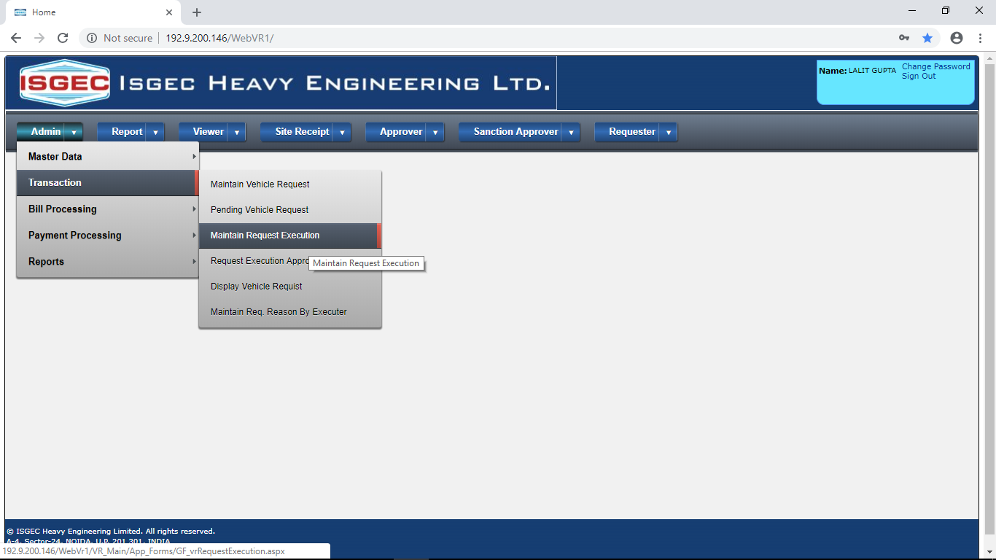
Execute Vehicle Request & Vehicle Placement
Click on Maintain Request Execution Menu Option.

Slide 4
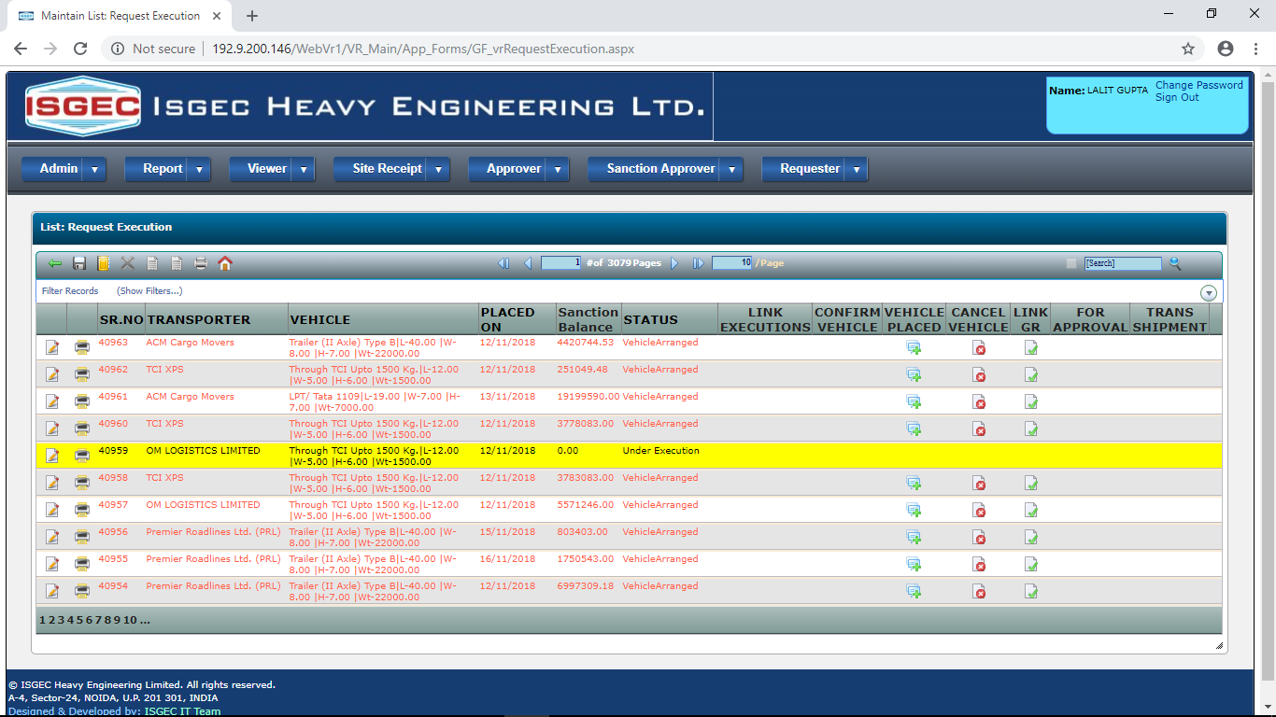
System will show already placed vehicles record.
Click on NEW button to create new request Execution.

Slide 5
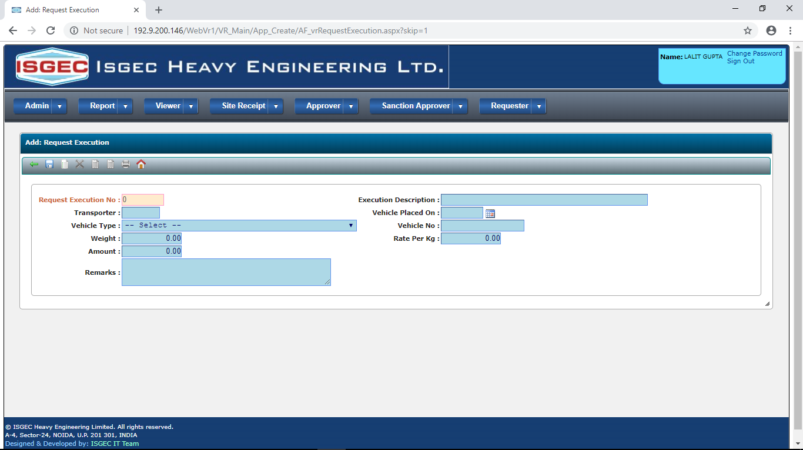
Following screen will appear.
Fill the details and Save The Record.

Slide 6
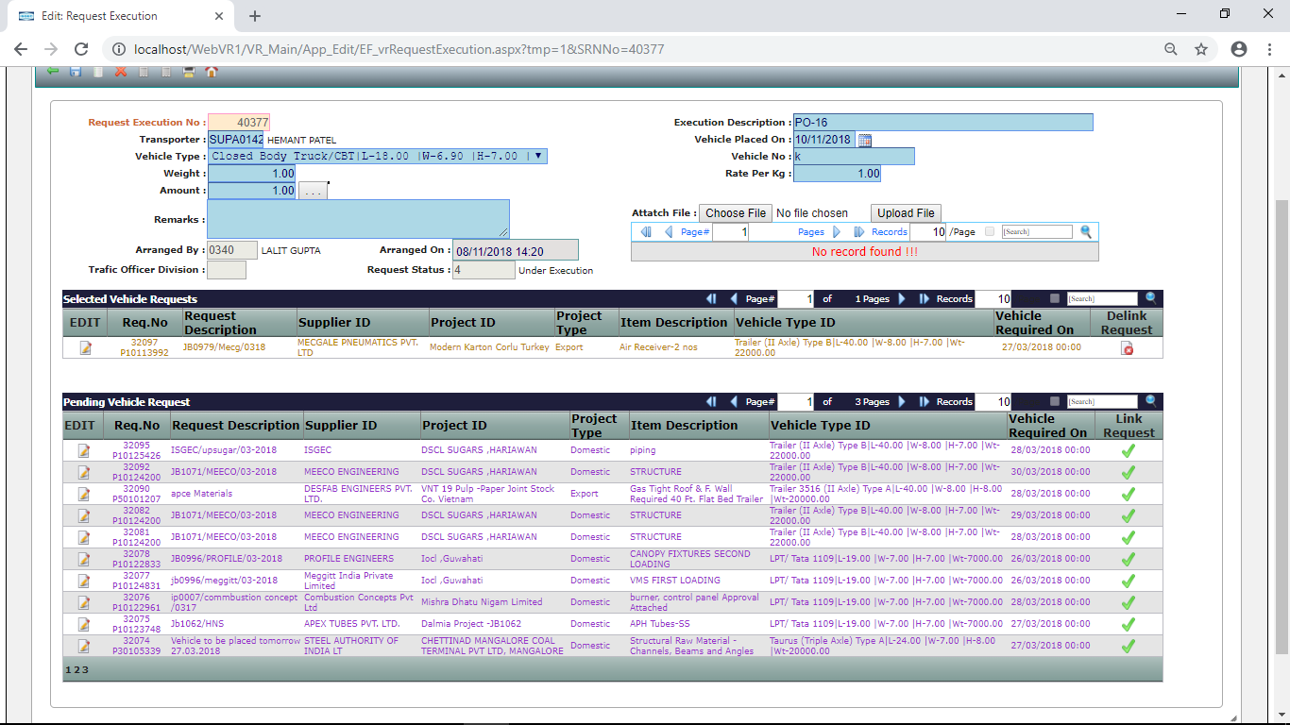
After Saving following screen will appear.
Click on Link Request to Select the Vehicle Request in this Vehicle Execution. After Linking Click Exit Button.

Slide 7
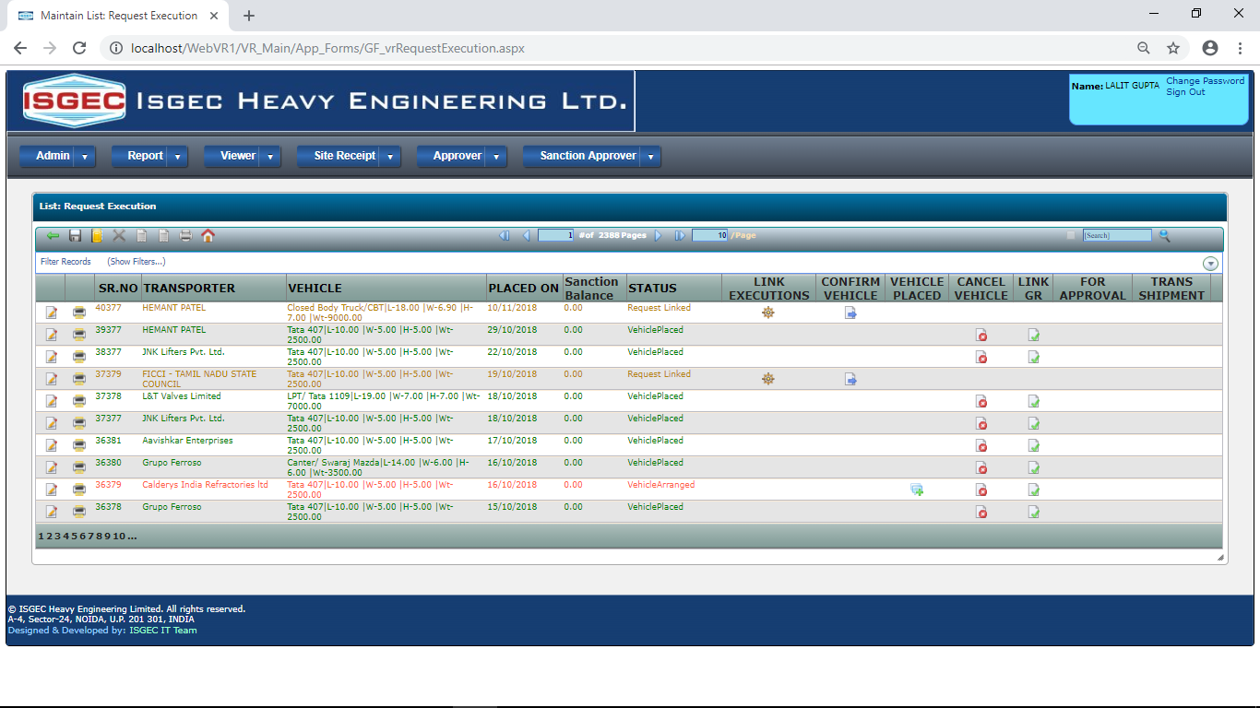
Recently created Request Execution will appear at top of the List.
Click on Confirm Vehicle to notify concerned and lock execution.

Slide 8
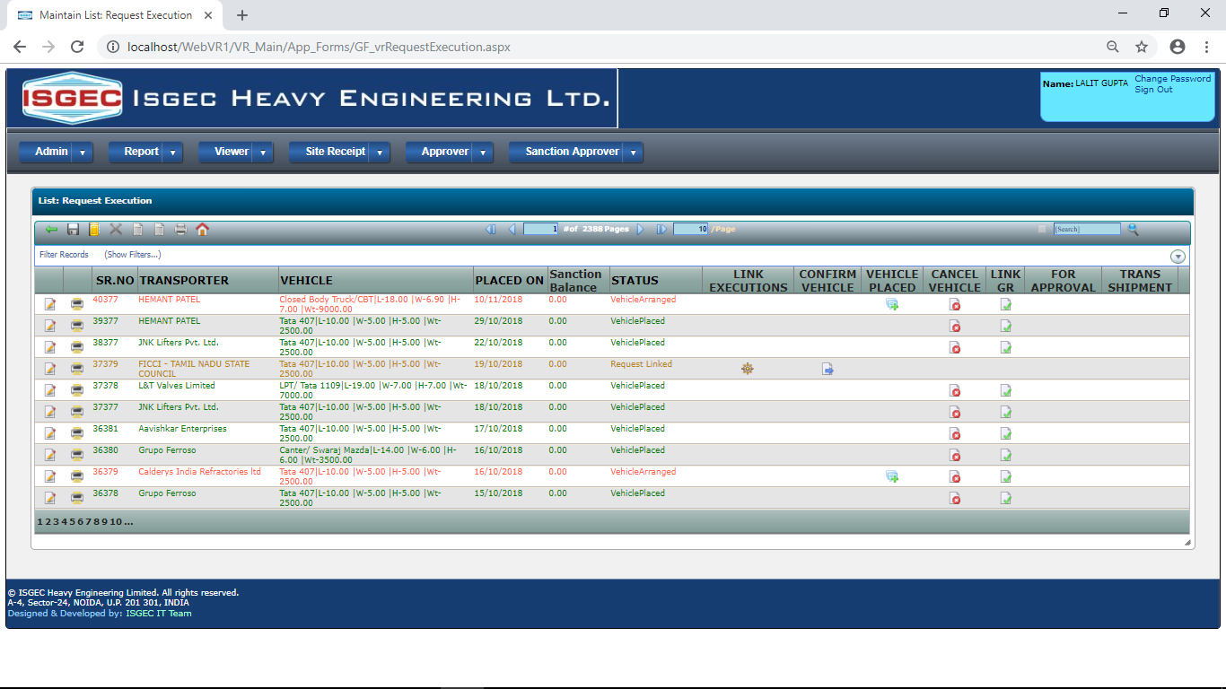
Confirm Vehicle Placed
When Vehicle is Confirmed, then Vehicle Placed Button will appear.
Click this button when you get confirm information about Vehicle is Placed at supplier Location.

Slide 9
END

